Slide 1
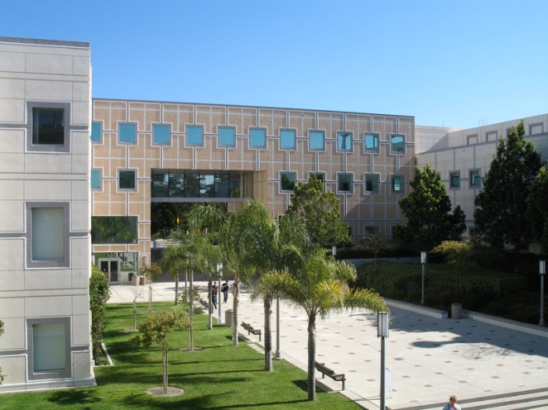
MAE 256 - Nanomechanics
Tim Rupert
Winter 2020
Atomic Scale Modeling for Mechanics

Slide 2
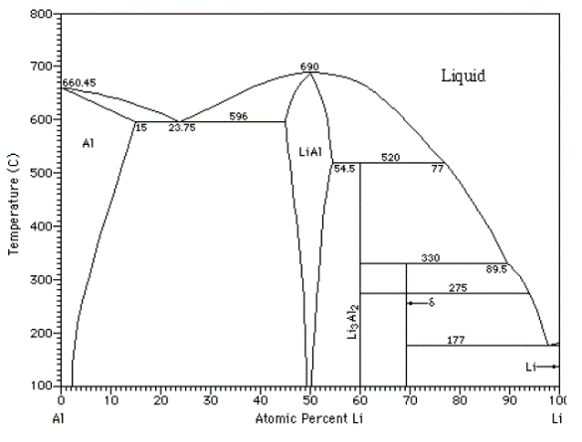
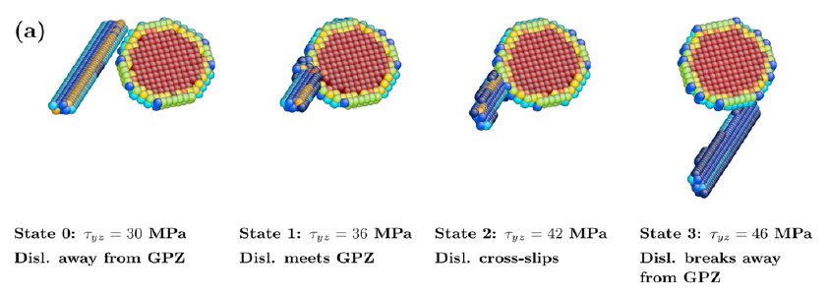
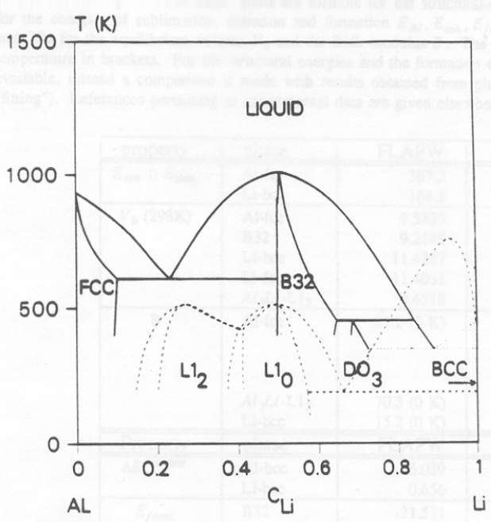
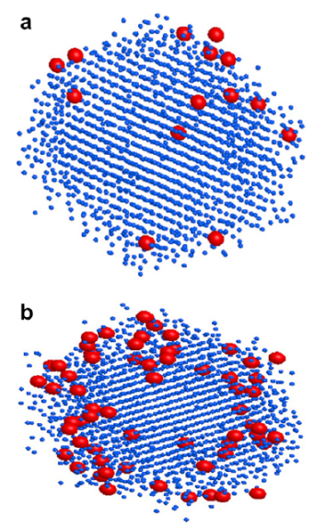
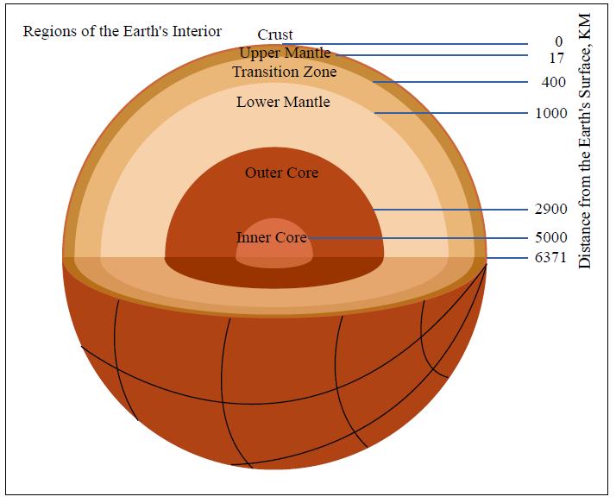
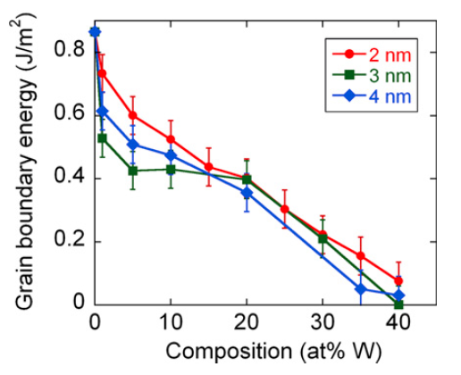
Why Model Materials?
Modeling lets you see things that are difficult or even impossible to observe through direct experimentation.
Control of environment (isolate important phenomena)
Resolution beyond what is experimentally possible
Prediction without experimentation
When experiment is impossible…
Experimental:
Calculated:
Singh et al., Scripta Mat. (2011).
Detor and Schuh, Acta Mat. (2007).
MIT OpenCourseWare

Slide 3
Simulation versus Modeling
Simulation is the imitation of a real-world process or system over time. This requires one to make no assumptions about the process. Modeling is the act of isolating a subsystem or process and then observing the outcomes. This requires assumptions to be made and requires an understanding of the connection between the subsystem and the material.
Real Situation:
Model:
Google Maps.
Massachusetts Bay Transportation Authority.

Slide 4
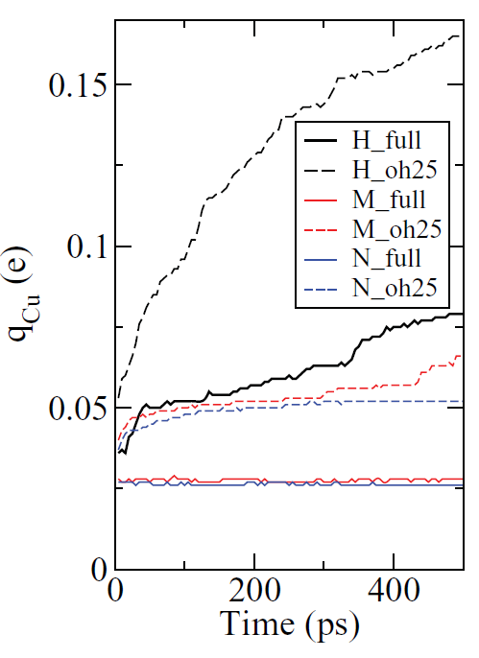
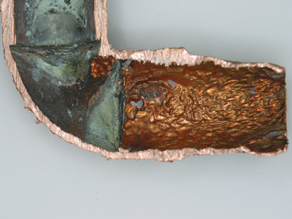
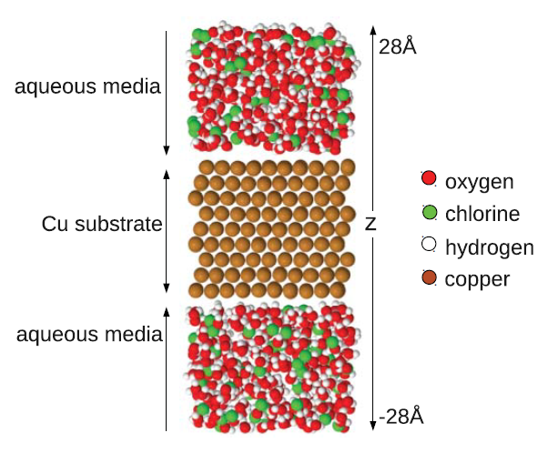
Simulation versus Modeling
Simulation is the imitation of a real-world process or system over time. This requires one to make no assumptions about the process. Modeling is the act of isolating a subsystem or process and then observing the outcomes. This requires assumptions to be made and requires an understanding of the connection between the subsystem and the material.
Corrosion of Copper:
Chlorine + hydroxide
Chlorine
http://www.copper.org
Water
Exact alloy composition
Changes to surface structure and chemistry
Complete representation of environment
Perfect representation of atomic interactions
Evolution of material and environment
Jeon et al., J. Chem. Phys. (2011).
Need to know the science of the field you are interested in to know what to compute!
“The hardest part of computing is knowing what to compute.” - Gerbrand Ceder (UCB)

Slide 5
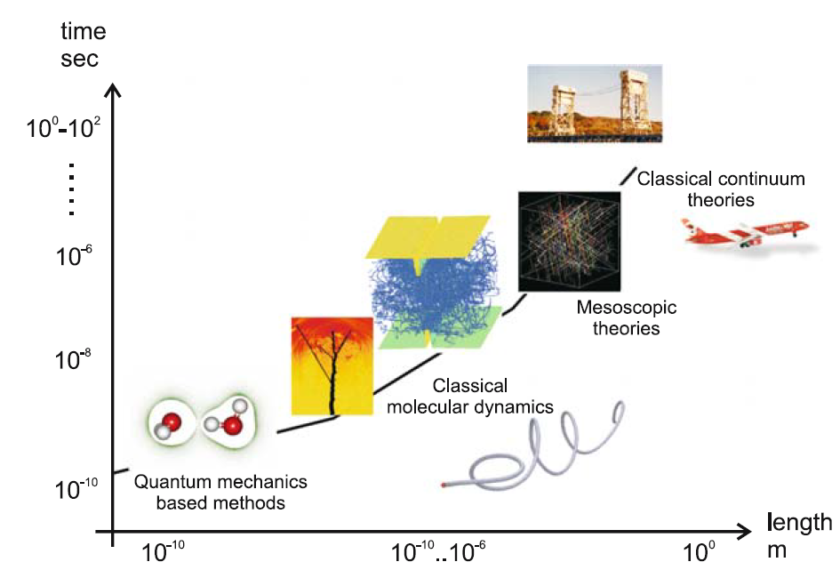
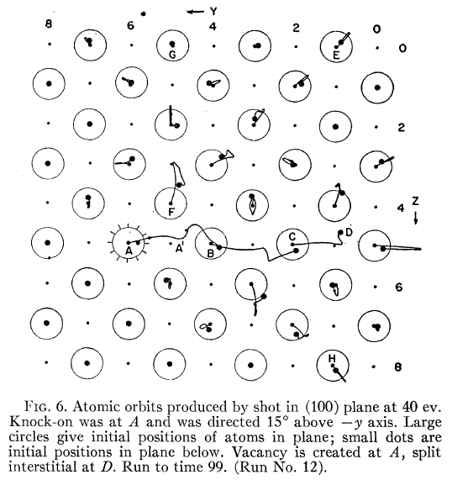
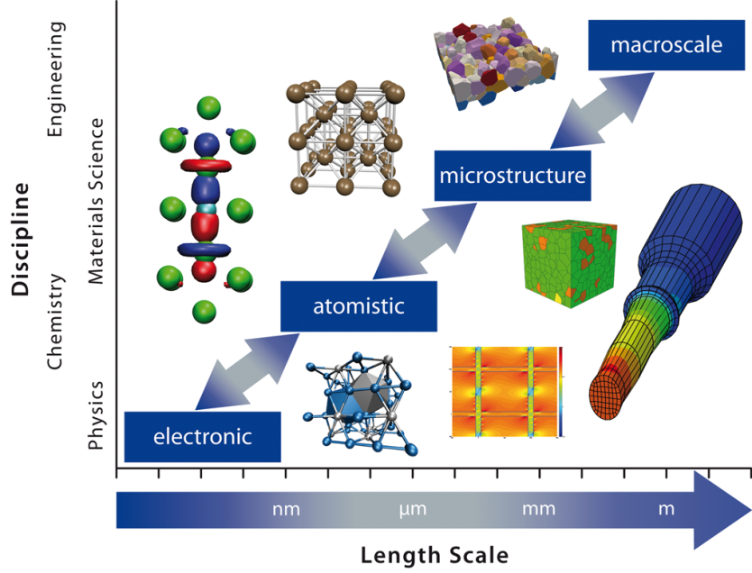
Modeling Across Length Scales
A variety of modeling techniques are available, often with a trade-off between the time and length scales that can be captured.
Representative Volume Element
Radiation Damage in Cu:
(First example of atomistic modeling in materials)
Classical Particles
What is most important for your problem?
Prof. Markus Buehler, MIT
Quantum Particles
The change in length scales also roughly mirrors the field of emphasis.
Gibson JB, et al. Physical Review (1960). (posted online)
http://www.icams.de

Slide 6
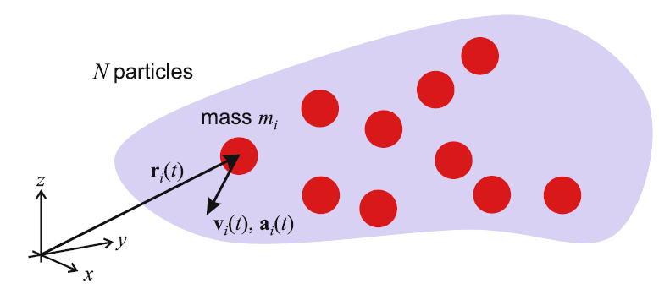
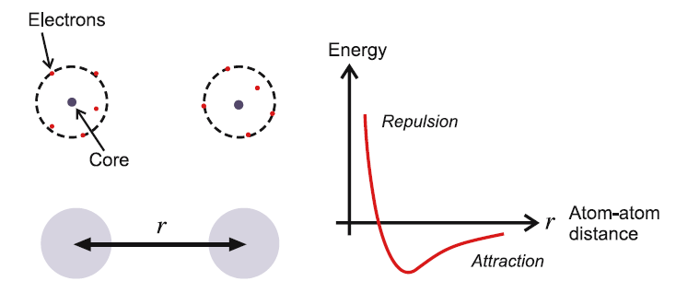
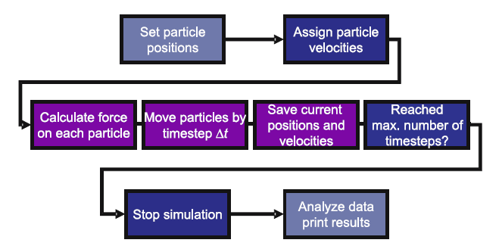
Molecular Dynamics
Molecular dynamics is an atomistic modeling technique that lets a system evolve over time by integrating Newton’s equations of motion. It is a deterministic technique.
Prof. Markus Buehler, MIT
Potential energy as a function of atom separation
Basic Numerical Scheme of MD:

Slide 7
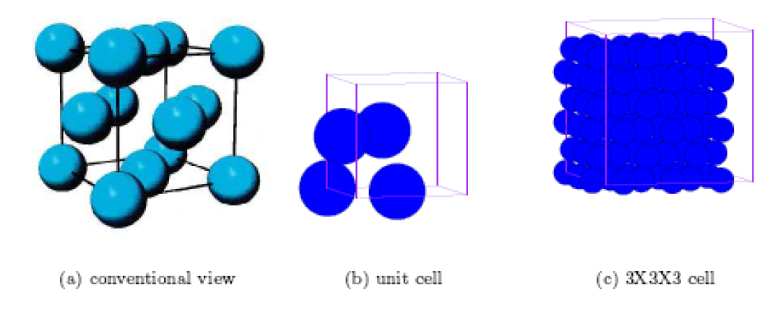
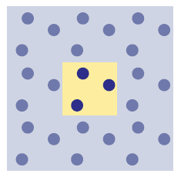
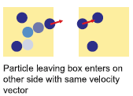
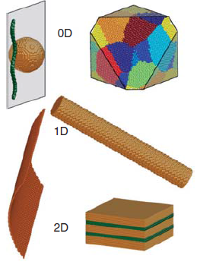
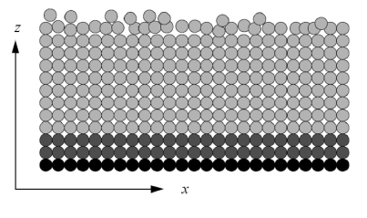
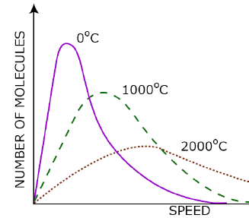
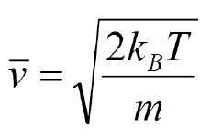
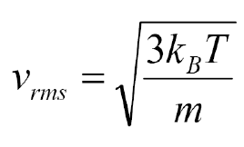
Model Setup
Must define initial atom positions, boundary conditions for your computational cell, and thermodynamic ensemble (what do we keep constant?).
Build Specimen:
Boundary Conditions:
Periodic
Temperature of our system is set by giving a distribution of velocities.
Free
Prof. Markus Buehler, MIT
Must always consider how BCs affect the process you are modeling.
Fixed
Maxwell-Boltzmann Statistics
Huang et al., MRS Bull. (2009).

Slide 8
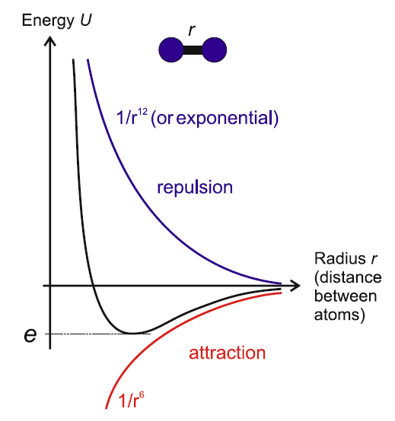
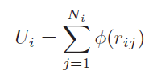
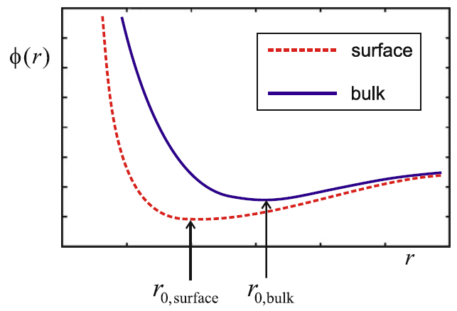
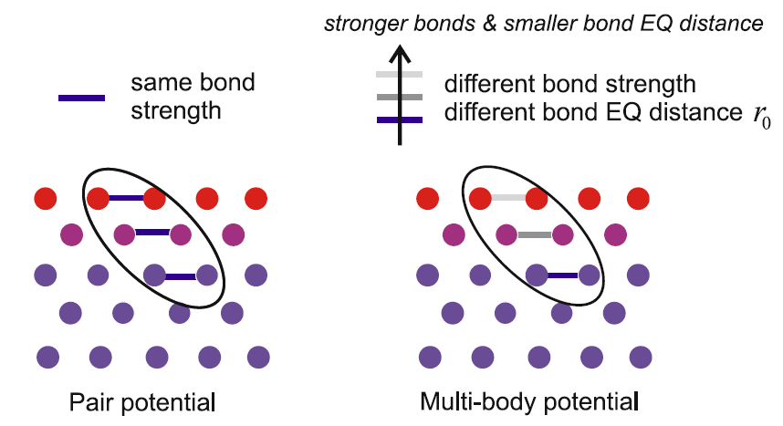
Interatomic Potentials - I
To compute forces between atoms, we need to know how potential energy changes as a function of separation distance.
Pair Potentials:
Assume that only atomic spacing matters
Limited number of fitting parameters means only a few properties can be recreated. We cannot recreate defect energies, all elastic constants, etc.
Lennard-Jones
We also miss important surface physics.
Many Body Potentials:
Add a term for electron density
Embedded Atom Method (EAM)
Tabulated to fit real material properties.
Prof. Markus Buehler, MIT

Slide 9
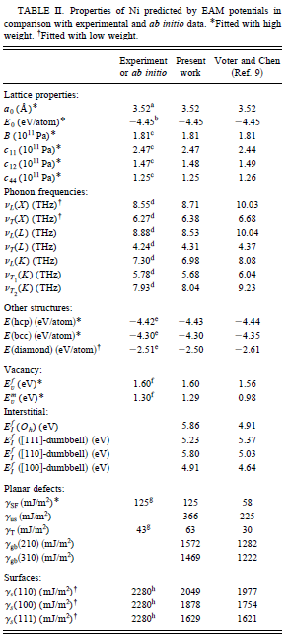
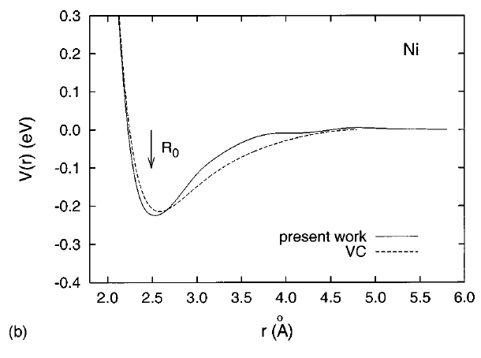
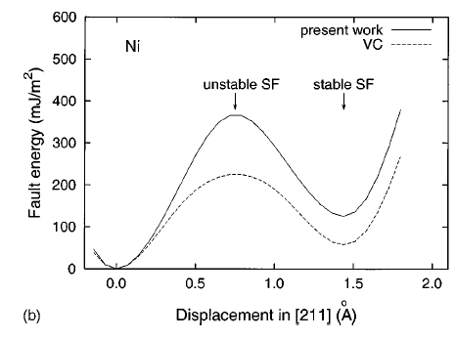
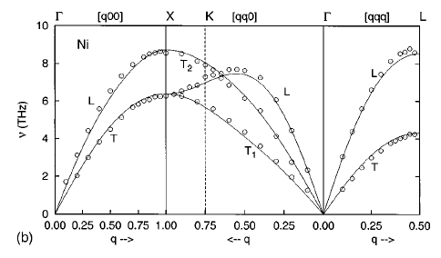
EAM for Ni
Mishin et al., Phys. Rev. B (1999).

Slide 10
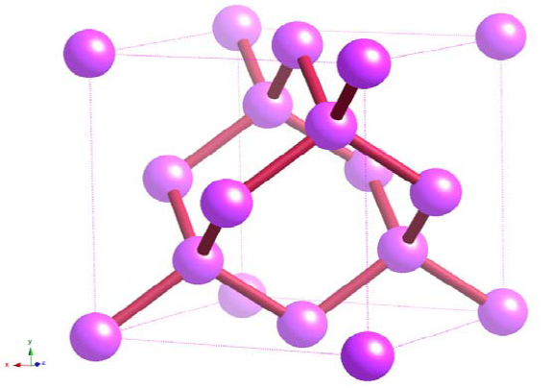
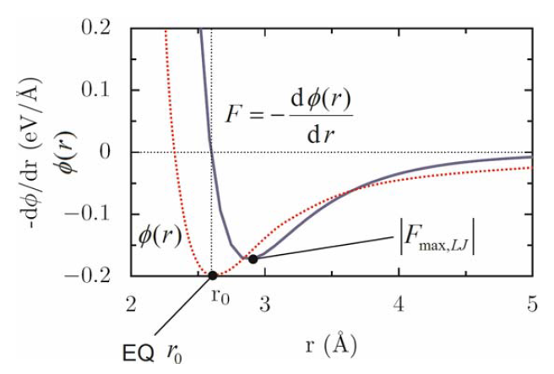
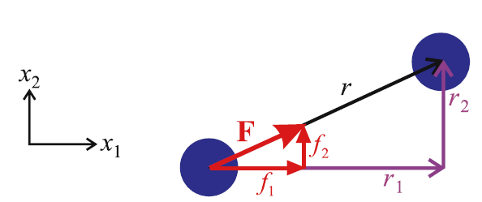
Interatomic Potentials - II
Potentials can get even more complicated to account for bond angle. This is necessary for materials which are directionally bonded, such as ceramics and semiconductors.
Angular Potentials: (e.g., Si)
2
3
Stillinger-Weber
Force Calculation:
Derivation of the potential energy w.r.t. distance gives us force, which we can then plug into Newton’s equations.

Slide 11
Time Integration Scheme
Armed with the masses, positions, and forces on our particles, we can integrate Newton’s equations of motion to find the positions and velocities of our atoms after a given time step.
Discretize in time…
$$r_{i}\left(t_{o}\right) →r_{i}\left(t_{o}+∆t\right)→r_{i}\left(t_{o}+2∆t\right)→r_{i}\left(t_{o}+3∆t\right)…→r_{i}\left(t_{o}+n∆t\right)$$
Perform a Taylor expansion of r_{i} around t_{o} …
Summing gives…
We now have a direct link between the new positions and the old positions and the acceleration! This is called the Verlet Central Difference Algorithm.
Positions at t_{o}-Δt
Positions at t_{o}
Accelerations at t_{o}
While creating codes to efficiently perform this integration and numerical schemes to speed it up were an important research task, you will likely never need to worry about this.
http://lammps.sandia.gov

Slide 12
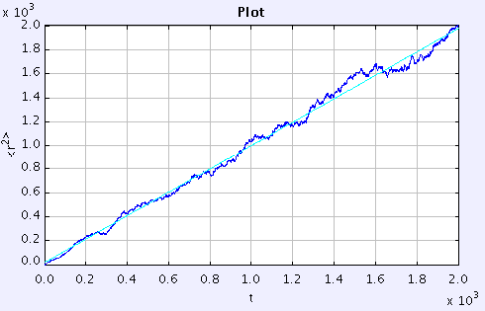
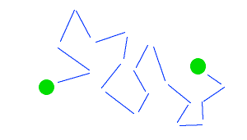
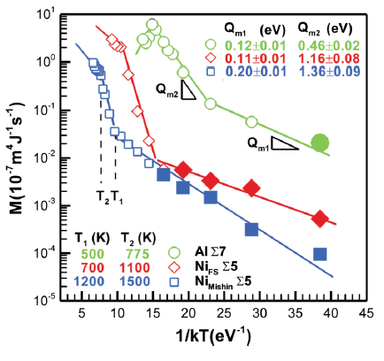
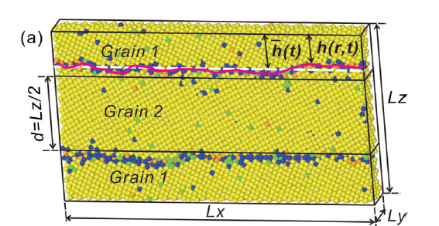
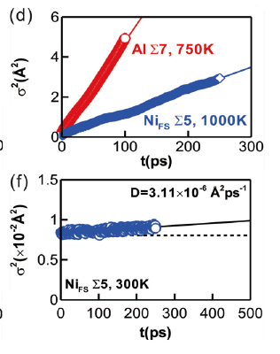
Case Study: Diffusion, GB Migration
The diffusion constant relates to the ability of a particle to move a distance Δr² over a time Δt.
Random Walk
$$D= \frac{1}{2d} \frac{{∆r}^{2}}{∆t}$$
d = dimensionality of the system
Slope → D
Δr
Alternatively, one could track GB motion and extract mobility.
Deng et al., Appl. Phys. Lett. (2012).

Slide 13
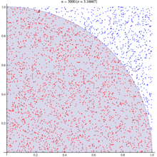
Monte Carlo Techniques
Instead of using deterministic methods and averaging over time, one could average over all possible microscopic states to find macroscopic properties.
Probability density distribution
How to calculate π?
Randomly sample phase space
Mark if we hit inside or outside the circle
$$\frac{\# in}{\# out}= \frac{\frac{1}{4}πr^{2}}{r^{2}}= \frac{π}{4}$$
We cannot know and describe all possible states. The trick to MC is to find an intelligent way to probe this phase space.

Slide 14
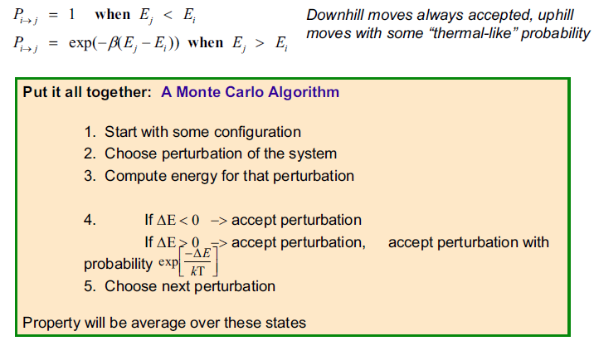
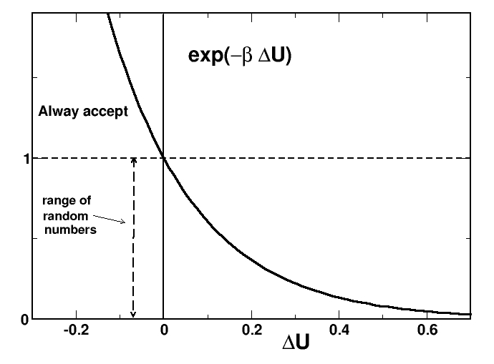
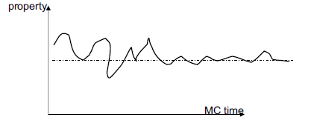
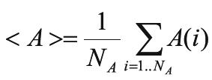
Metropolis Algorithm
Couple statistical mechanics framework with the idea of thermally-activated physics.
Average from here
You will preferentially sample the minimum energy state!

Slide 15
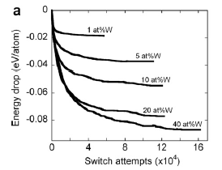
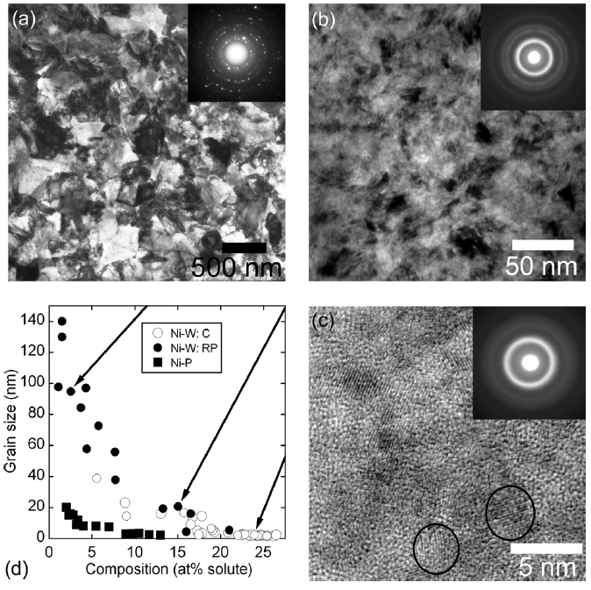
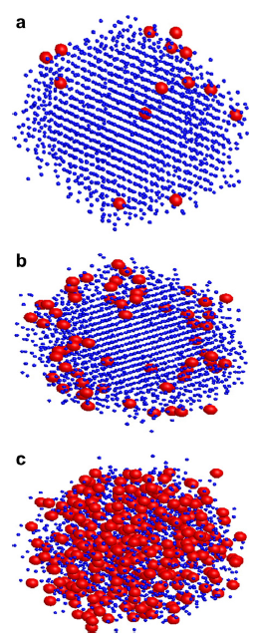
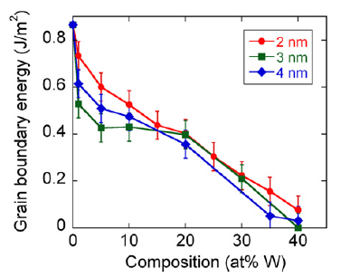
Case Study, Implementation
Look at alloying Ni with W atoms. Experiments show that increasing W composition decreases grain size. What causes this?
Experimental Data
Blue = Ni
Red = W
Detor et al., Acta Mat. (2007).
Like MD, the majority of the hard work has been done for you!
Detor and Schuh, Acta Mat. (2007).
http://spparks.sandia.gov

Slide 16
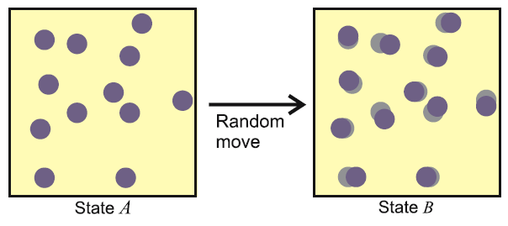
MD versus MC
Like everything in life, there are pluses and minuses to both methods.
Molecular Dynamics
Can capture dynamic events (dislocation interactions, kinetics of GB motion, twinning, etc.)
Can model nonequilibrium processes and microstructures
Can calculate transport properties
All required info can be derived from first principles (quantum mechanics)
Do not know if you have reached an equilibrium state
Monte Carlo
Can access equilibrium configurations, but does not provide info about how system moved from A to B
Better for simulating phase transitions
Can simulate the effects of varying the number of particles in your system
No objective definition of time!

